Slide 1
Cloud Core MBA
Azure Architecture Design Session

Slide 2
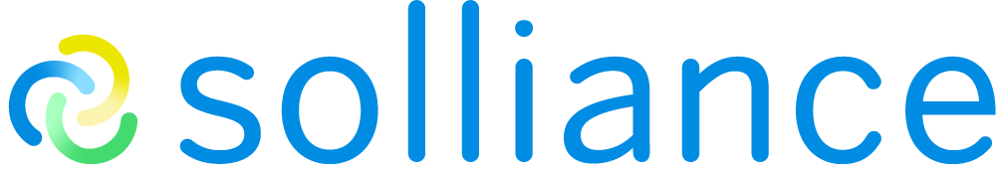
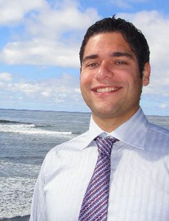

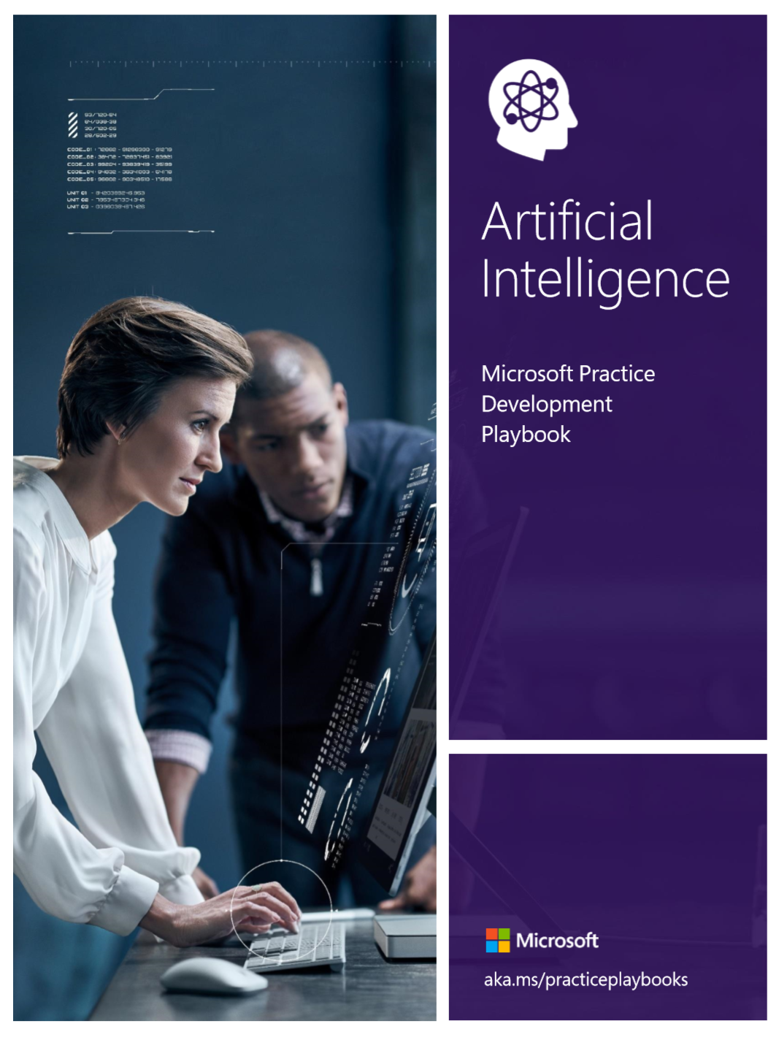
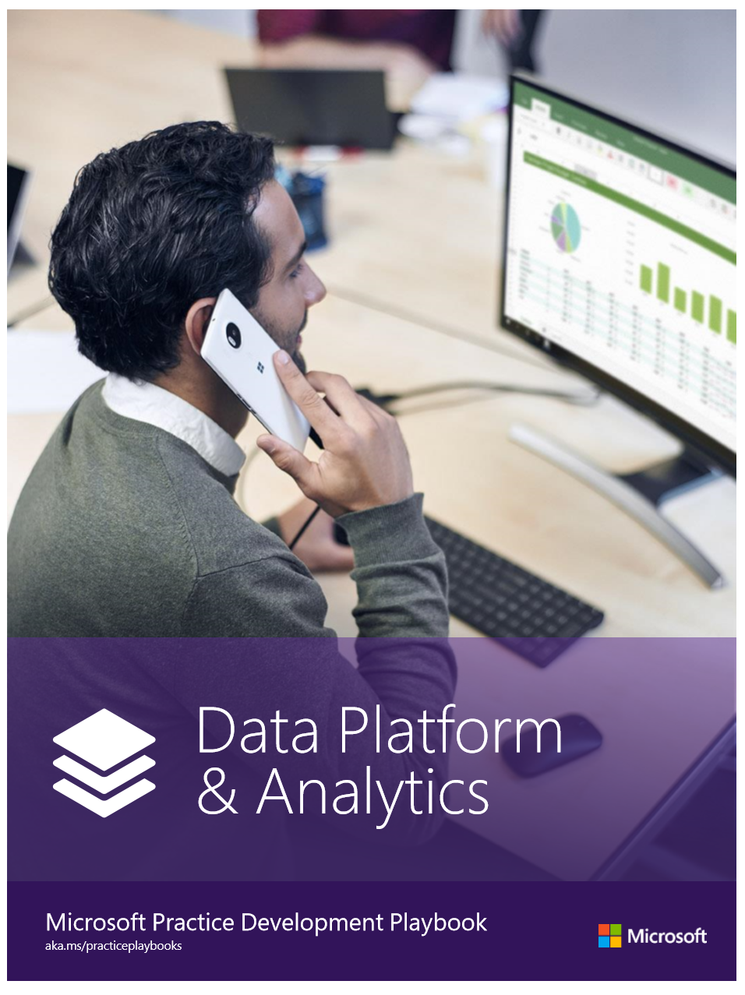
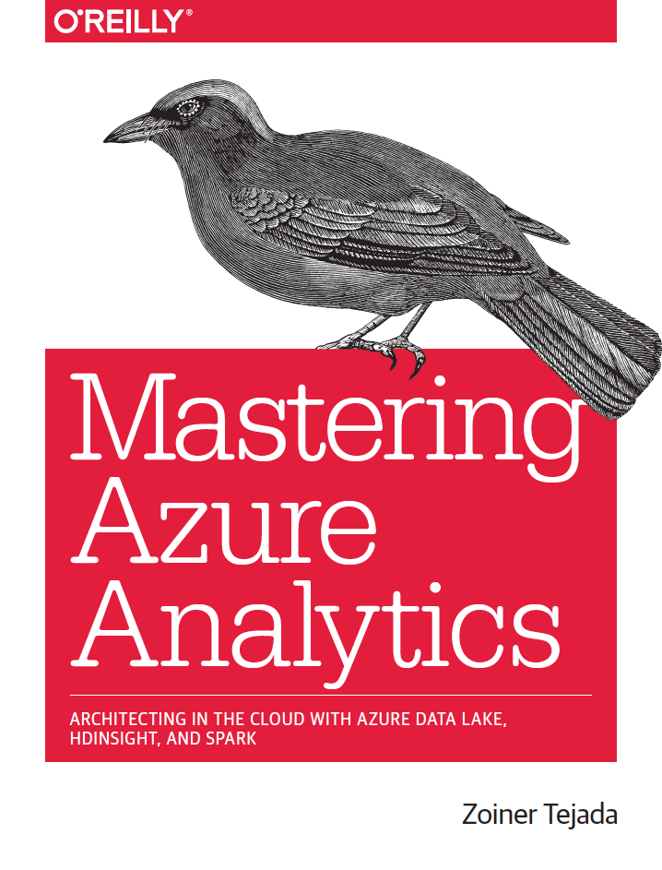
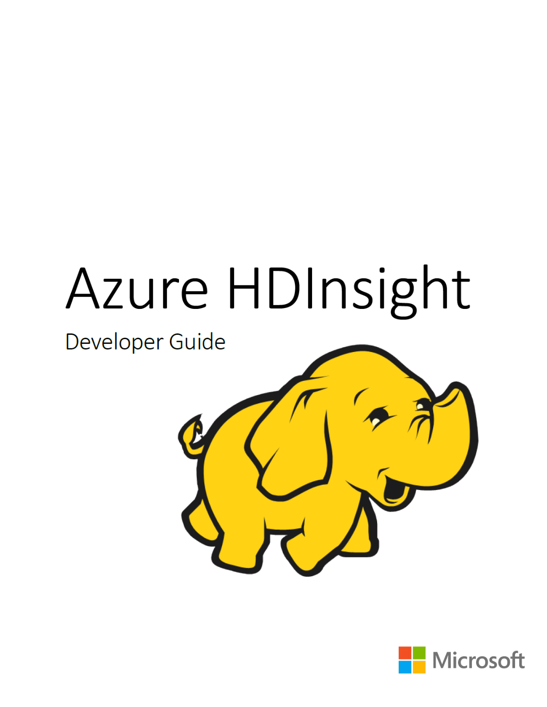

Solliance Founder, CEO
Author of a dozen books on Azure
Microsoft AI, Azure MVP
Microsoft Regional Director
Zoiner Tejada
zoinertejada@solliance.net
@zoinertejada

Slide 3
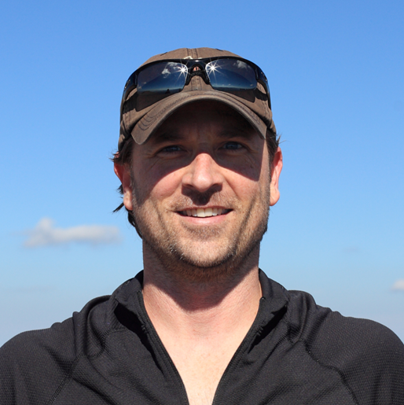
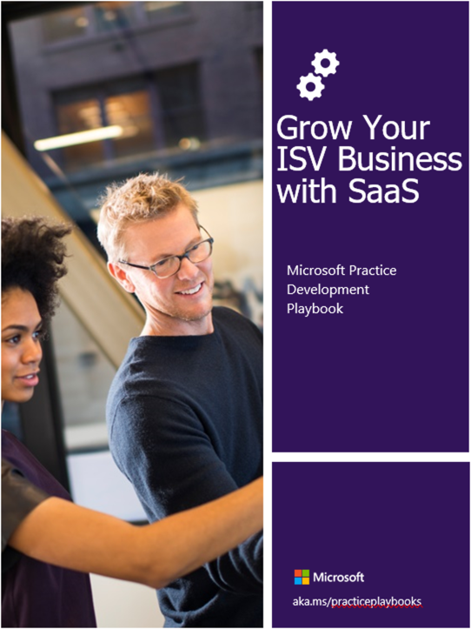
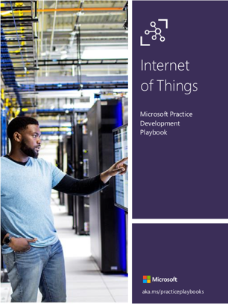
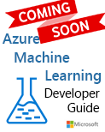
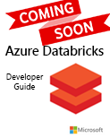

Data engineer and cloud architect
MBA
Author / contributor on multiple books on Azure
Kyle Bunting
kyle@solliance.net

Slide 4
Our Journey Together Today
To experience the Azure value proposition the way most customer’s do:
by realizing a solution in Azure, going from requirements to design to working solution without getting overly technical.
Fundamentals
Azure Value Prop
Mini-ADS
Requirements
Mini-ADS
Hands-on PoC
MBA Perspective
Design
Solution Presentation
Table to table

Slide 5
Abstract
In this workshop, you will participate in an Architecture Design Session (ADS), so you get to experience the key steps in the design process. You will then review an implementation of one possible solution to the customer requirements presented in the ADS, providing you with hands-on knowledge of how Azure delivers value to customers.

Slide 6






Understanding the Azure value proposition
Agility
Instant Provisioning
DevOps and CI/CD
Migrate & Modernize Applications
Faster Time to Market
Service Quality
Performance
Scalability
Availability
Reliability
New Scenarios
Insights through data
Machine Learning
Artificial Intelligence
IoT
Digital Transformation
Costs
CapEx → OpEx
Transparency
Cost Savings
Trusted
Comprehensive compliance and data privacy standards
Multiple layers of security
Notes:
Complete set of integrated cloud offerings, from IaaS to PaaS to SaaS.
Unmatched global scale (54 regions available in 140 countries)
Built-in security + comprehensive compliance certifications
Analytics and built-in intelligence

Slide 7
Perspective of a technical MBA
20+ years in technical positions across multiple industries, from Department of Defense to insurance to education
Earned my MBA in 2016 from the Krannert School of Management at Purdue University
Seen first-hand the business transformation through the return of innovation enable by Azure
Worked for an organization struggling to shift from CapEx to OpEx
Helped a company realize the benefits of geographic distribution in Azure
My one bit of guidance to you
Notes:
Removal of infrastructure management
Cost savings through smaller IT footprint
Integration with Office 365, Microsoft Dynamics 365, Power Platform
Comprehensive analytics capabilities allow companies to better understand their customers and how they are using their applications
Easy to quickly enhance applications by chaining Azure services and using serverless technologies
If we define a value proposition as the benefits a customer gains from your products and services, then…
The Azure value proposition is that it enables organization to remain focused on delivering on their value proposition.

Slide 8
Your challenge, should you choose to accept it…
The ADS

Slide 9
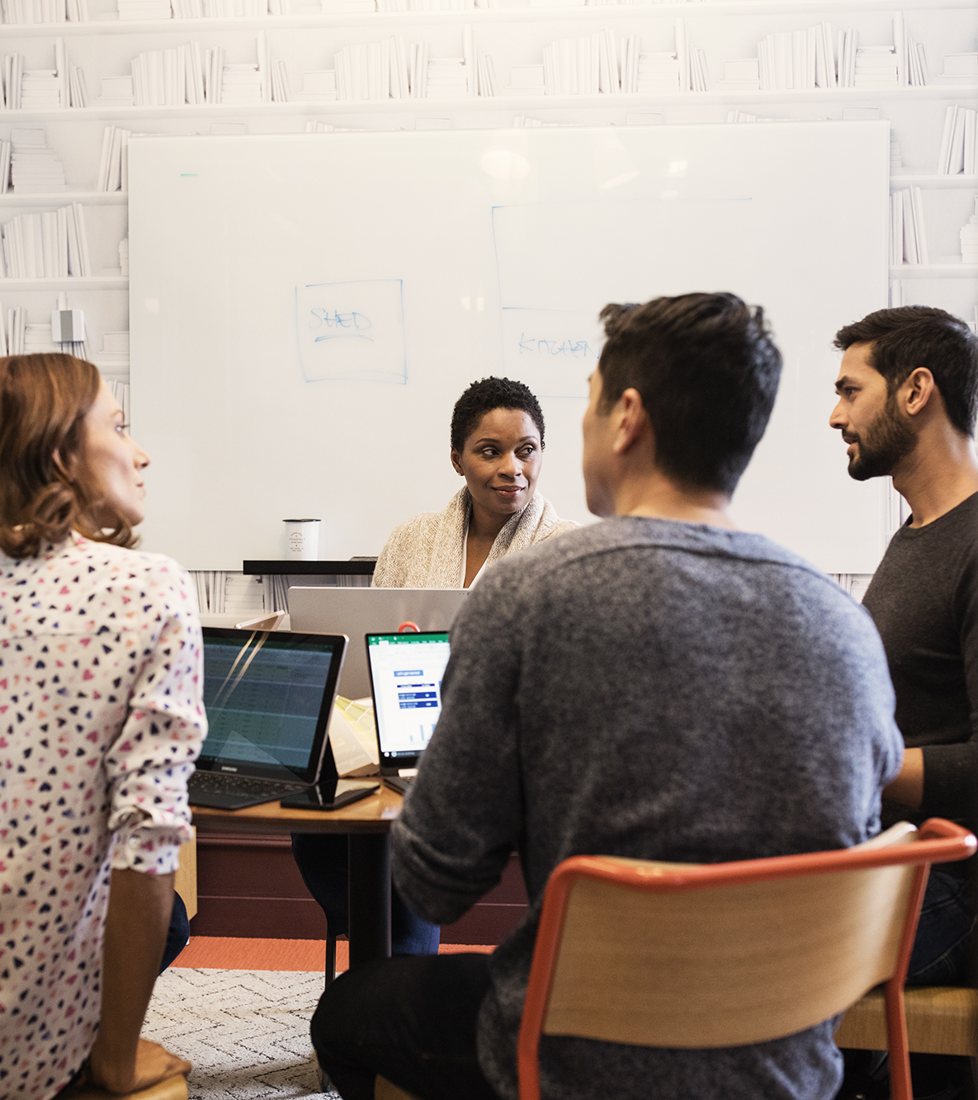

What is an ADS?
An Architecture Design Session (ADS) is a one- to multi-day engagement driven by technical sales that maps technical solutions to customer opportunities.

Slide 10
The goal for the customer, is to get a solution designed and deployed. Increasing Azure consumption is the Microsoft goal. The ADS supports both goals, either via a pilot or direct production implementation, or through projects that de-risk critical aspects along the way.
What are the
ADS outcomes?

Slide 11
Example ADS activities including pre & post work
Before the ADS
Preliminary requirements clarification | 9:00 am - 9:30 am
Ideation & Baseline/Candidate Architecture Discussion | 9:30 am - 10:30 am
During the ADS
 | Day 1
Detailed discovery | 9:00 am - 12:00 pm
Envisioning | 1:00 pm - 5:00 pm
 | Day 2
Whiteboard Candidate Architecture(s) | 9:00 am - 12:00 pm
Identify and define POC and Pilot(s) | 1:00 pm – 4:00 pm
Document high level deliverables and next action steps | 4:00 pm – 5:00 pm
This work can be performed remotely.
After the ADS
Create architecture diagrams | *Varies by project
Review architecture diagrams with ADS team | 9:30 am - 10:30 am
This work can be performed remotely.
The ADS should be performed in-person.

Slide 12
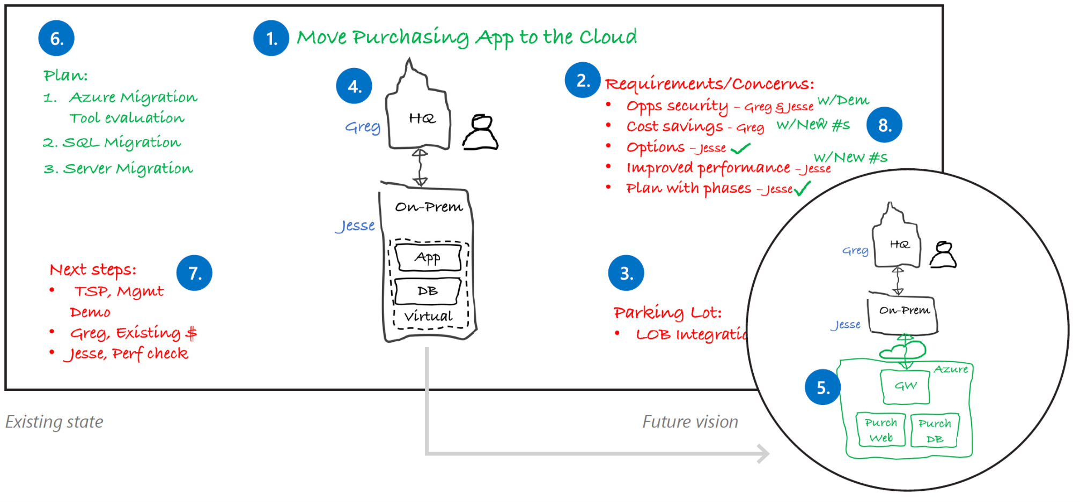
Proven practice whiteboard layout
Project Goal
Plan
Requirements
Future State
Next Steps
Current State
Parking Lot
Notes:
Whiteboards and Surface Hub support the type of collaboration you’ll need for a successful ADS.
Focus on your stakeholders, use the whiteboard as a tool for recording ideas, and get approval at each step before moving forward.
1. Project goal
Write down the project goal to help focus everyone to the desired outcomes.
2. Requirements and concerns
Begin with the items you’ve listed from the pre-call. Make sure that everyone gets a chance to be heard. Write down names next to each person’s requirements or concerns.
3. Parking lot
Acknowledge out-of-scope items. Help people set these concerns aside for later and focus back on the topic at hand.
4. Current state
Diagram the current state and ownership in black. The customer may help diagram this on the whiteboard. Be careful with technical depth. Focus on the system details that affect the ADS outcomes.
5. Future vision
Capture a high-level view of what the customer really wants in green before diving into technologies. Help customers envision the potential opportunities with Microsoft technologies.
6. Implementation plan
Break the plan into clear steps so the customer can track the project schedule and budget flexibility.
7. Next steps
Assign immediate action items during the meeting.
8. Wrap-up
Verify with all stakeholders that their requirements and concerns have been sufficiently addressed with the solution and plan. Close with agreement on the next steps.

Slide 13
Performing an ADS for
Contoso Sports League Association

Slide 14

Customer situation
Contoso Sports League Association is one of the worlds largest sports franchises
They run a highly successful e-commerce website
Have back-end website to support call center
Need to maintain PCI DSS Level 1 compliance
Notes:
e-commerce website sells merchandise to their legions of sports fans.
built using ASP.NET
Currently hosted in a co-lo.
They also have a backend website that supports their call center. Call center employees use this admin website to view customer orders.
They accept payment by credit card, and owing to their high annual volume (in the tens of millions, processing about 50K per day) of transactions, need to ensure that they are PCI DSS Level 1 compliant.
Their website hosts the shopping cart and checkout process
They defer the credit card authorization and capture responsibilities of the credit card processing to a third-party payment gateway.
This payment gateway provides a web API that is invoked over TLS from Contoso server side logic.
The call includes the credit card holder data (name, number, etc.) and returns a status indicating a success or failure in authorizing and capturing payment against the credit card.

Slide 15
Customer needs
Migrate existing solution into PaaS services
Ensure data privacy and protection
Provide better management of usernames and passwords
Add failover capabilities
Enhance application functionality with serverless cloud services

Slide 16
Customer objections
Can we provide a solution that scales to meet our public demand, but is also secure for use by our call center and backend services?
What options are available for performance monitoring?
How can Azure Trust Center help with PCI compliance?
Is it possible to automatically failover the database without having to update connection settings in our applications?
Can we conduct audits and penetration testing against an Azure data center?

Slide 17
Let’s start the “mini” ADS!
Your team is at your table.
Each of you should go to the guide
http://bit.ly/cc-mba-guide
3. You have 60 minutes to work thru the guide as a team.
There are proctors to help you
We’ll start a timer ;-)

Slide 18
Time for the Hands-on PoC
Next, you will explore the PoC your MS team helped to implement.
Each of you should go to the lab guide
http://bit.ly/cc-mba-lab
3. You have 60 minutes to work thru the guide as a team.
We will distribute users/passwords
There are proctors to help you
We’ll start a timer ;-)

Slide 19
Your Azure account
Download this
http://bit.ly/cc-mba-deck
For the hands-on lab portion of this workshop, you will use the following user accounts:
Table 1: CloudCoreMba-01@solliancecc.onmicrosoft.com
Table 2: CloudCoreMba-02@solliancecc.onmicrosoft.com
Table 3: CloudCoreMba-03@solliancecc.onmicrosoft.com
Table 4: CloudCoreMba-04@solliancecc.onmicrosoft.com
Table 5: CloudCoreMba-05@solliancecc.onmicrosoft.com
Table 6: CloudCoreMba-06@solliancecc.onmicrosoft.com
Table 7: CloudCoreMba-07@solliancecc.onmicrosoft.com
Table 8: CloudCoreMba-08@solliancecc.onmicrosoft.com
Table 9: CloudCoreMba-09@solliancecc.onmicrosoft.com
Table 10: CloudCoreMba-10@solliancecc.onmicrosoft.com
All accounts use the password: CloudCore123

Slide 20
It’s show time!
Finally, you will present back your solution to a table next to you.
Prepare your presentation – you have 15 minutes. Be sure to explain your understanding of the solution, how it meets the customers needs, explain the Azure value proposition, and do a demo!
You have 15 minutes to present. Then the other table gets a chance to present to you.

